Slide 1
TP53 mutations that are associated with an increased Copy Number Variation
Cancer Bioinformatics - Final Project
Ornit Bhonkar
March 19, 2026

Slide 2
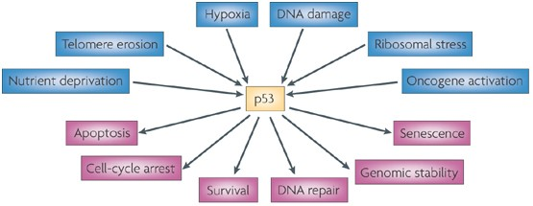
TP53
Background
TP53 acts as the cellular “superhero” responsible for maintaining genomic integrity. It functions as a stress sensor that responds to DNA damage.
When TP53 is functional, it induces DNA repairs or apoptosis. When broken, errors accumulate.
TP53 mutations are not binary, and they exist on a spectrum of phenotypic impact.

Slide 3
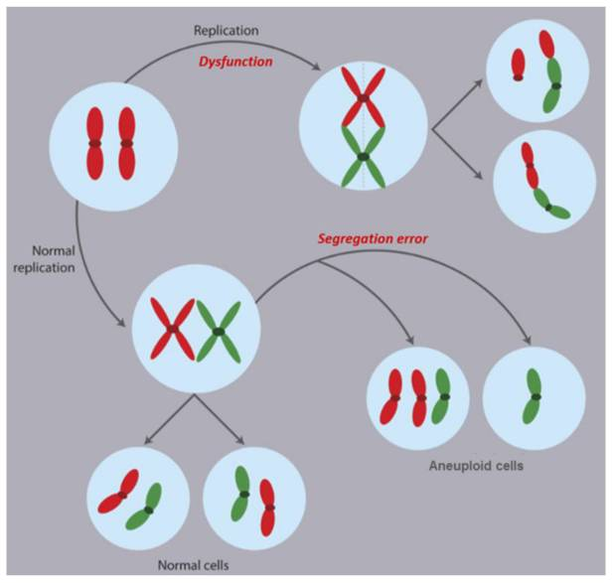
Copy Number Variation
Background
A stretch of DNA where the number of copies differs from the normal two copies.
copies → RNA → protein
copies → protein
Example: Oncogene amplification → uncontrolled growth
Fraction Genome Altered (FGA)
(number of base pairs with
copy number gain or loss)
__________________________________________
=
(total base pairs profiled)

Slide 4
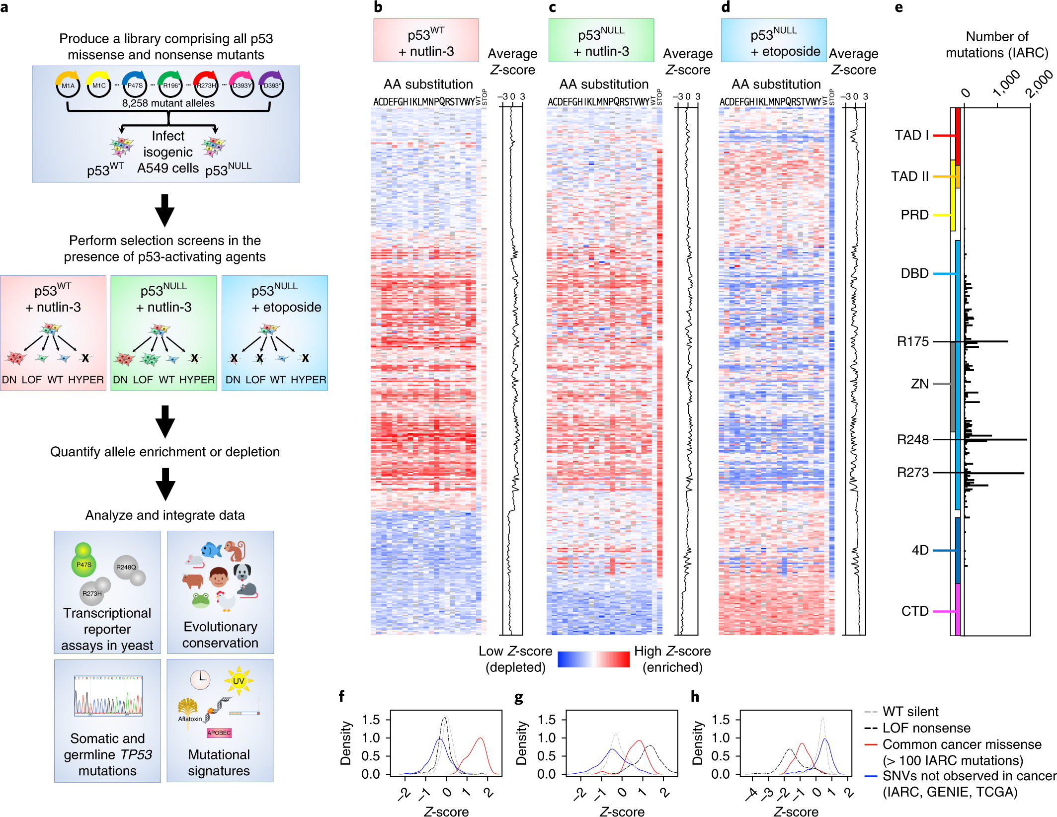
Experimental Functional Score
Background
1
Screen 8,258 TP53 Variants
Combined Phenotype Score (EFS)
Low = Loss of Function
High = WT-like Activity
Quantify Allele Enrichment
2
3
Calculate Functional Score
Giacomelli, A.O., Yang, X., Lintner, R.E. et al. Mutational processes shape the landscape of TP53 mutations in human cancer. Nat Genet 50, 1381–1387 (2018).

Slide 5
Experimental Functional Score
Background
1
Screen 8,258 TP53 Variants
Combined Phenotype Score (EFS)
Low = Loss of Function
High = WT-like Activity
2
Quantify Allele Enrichment
2
3
Calculate Functional Score
Giacomelli, A.O., Yang, X., Lintner, R.E. et al. Mutational processes shape the landscape of TP53 mutations in human cancer. Nat Genet 50, 1381–1387 (2018).

Slide 6
Experimental Functional Score
Background
1
Screen 8,258 TP53 Variants
[Z(WT+nutlin) + Z(NULL+nutlin) - Z(NULL+etop)]
____________________________
3
EFS
=
Combined Phenotype Score (EFS)
Low = Loss of Function
High = WT-like Activity
3
Quantify Allele Enrichment
2
3
Calculate Functional Score
Giacomelli, A.O., Yang, X., Lintner, R.E. et al. Mutational processes shape the landscape of TP53 mutations in human cancer. Nat Genet 50, 1381–1387 (2018).

Slide 7
Hypothesis
Background
iNITIAL Hypothesis
Patients with TP53 mutations that have the
lowest experimental function scores (EFS) will show
the highest Fraction Genome Altered (FGA)

Slide 8
Research Questions
Background
Is there a correlation between the experimental TP53 EFS (Giacomelli et al.) and patient FGA (GENIE)?
Do "Hotspot" mutations drive higher genomic instability than rare mutations?
Does this correlation hold true across all cancer types or is it specific to certain tissues?

Slide 9
Data Sources: Integrating Phenotype & Genotype
Background
Giacomelli et al., Nature Genetics, 2018 (25,217 variants, 8,274 unique)
Role: Experimental "fitness" scores for every possible TP53 mutation - the genotype
Metric: Experimental Functional Score (derived from cell line fitness screens) quantifies exactly how well each specific TP53 mutant can suppress tumor growth in a controlled lab setting
AACR GENIE v19.0 (~271,000 samples, 100,418 with FGA).
Role: Real-world patient data - the phenotype
Metric: FRACTION_GENOME_ALTERED (FGA), a quantitative measure of chromosomal instability
35,357 TP53-mutant
65,061 TP53-WT
Goal: to show that the physical structure of the genome is breaking down

Slide 10
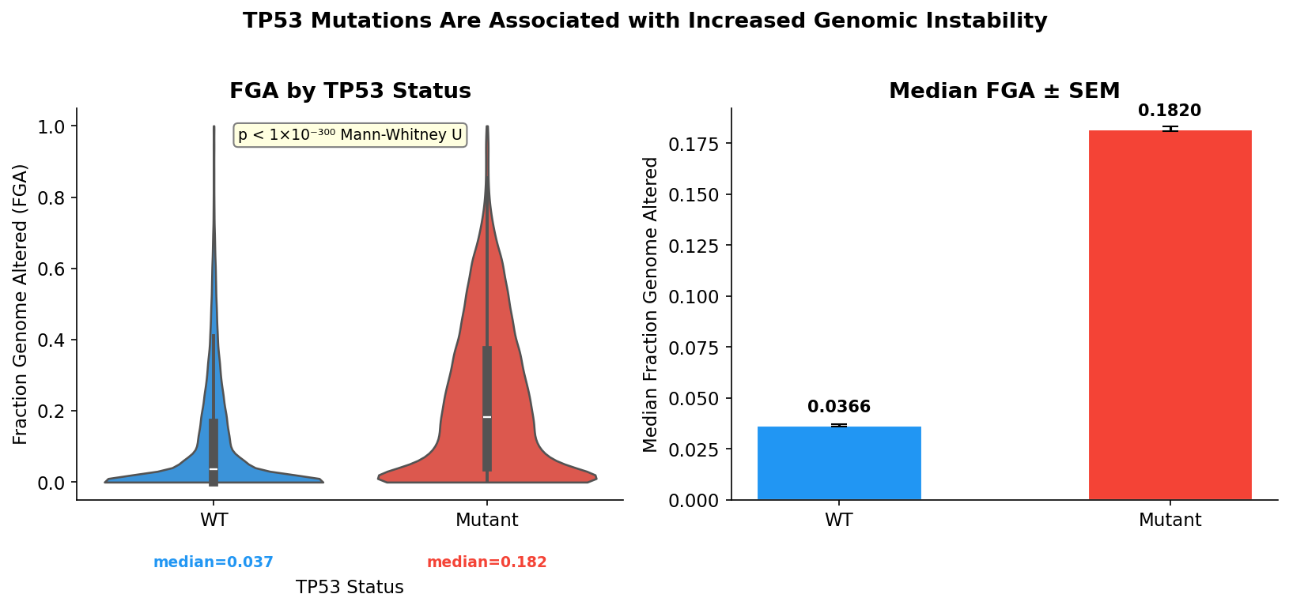
Results
Do TP53 mutations correlate with higher genomic instability (FGA)?
TP53 mutant tumors have significantly higher FGA than WT (median 0.182 vs 0.037, p < 1×10⁻³⁰⁰)

Slide 11
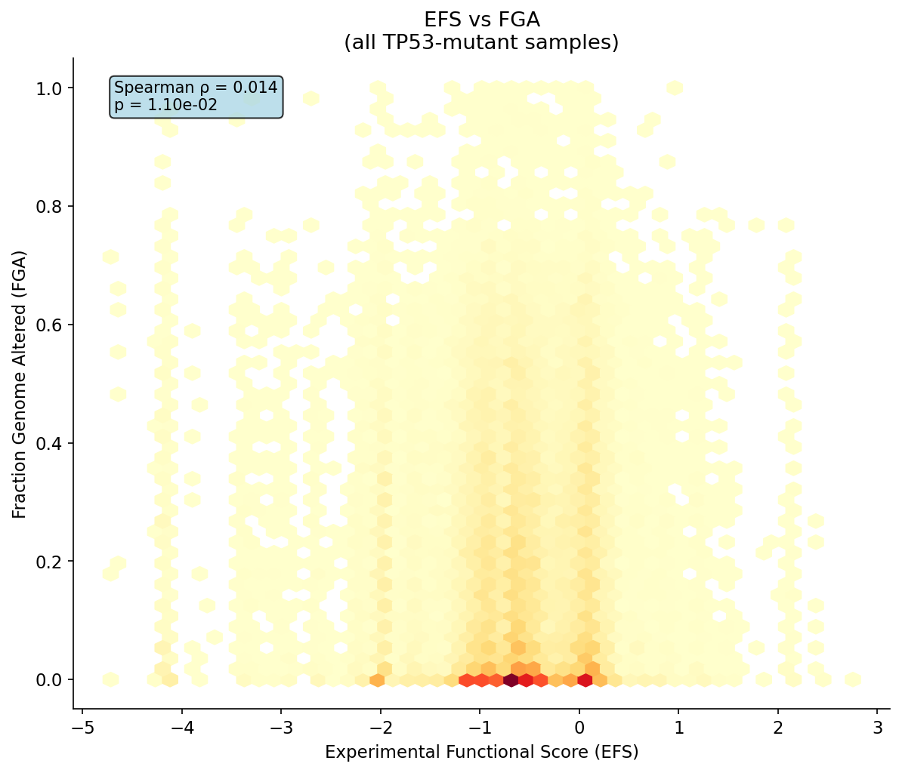
Results
Is there a correlation between EFS and FGA?
Weak correlation. The hypothesis partially holds but EFS alone doesn't predict FGA well

Slide 12
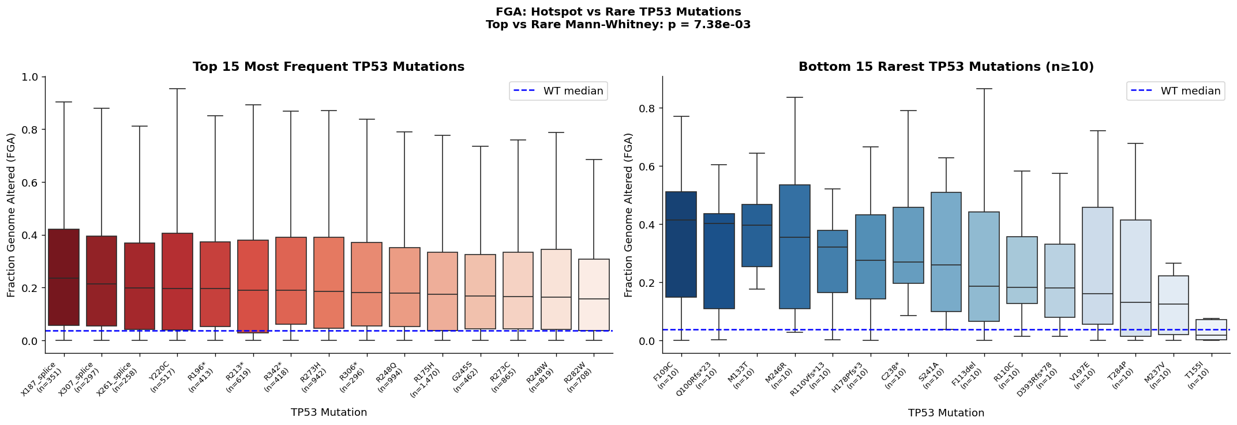
Results
Do "Hotspot" mutations drive higher genomic instability than rare mutations?
Rare mutations have higher median FGA. ”Hotspot” mutations have lower FGA median than rare mutations

Slide 13
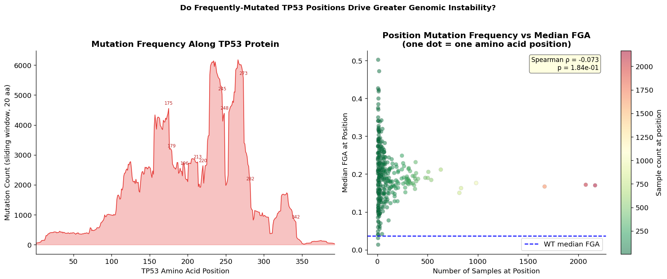
Results
Do "Hotspot" mutations drive higher genomic instability than rare mutations?
The loss of TP53 function itself drives genomic instability uniformly.

Slide 14
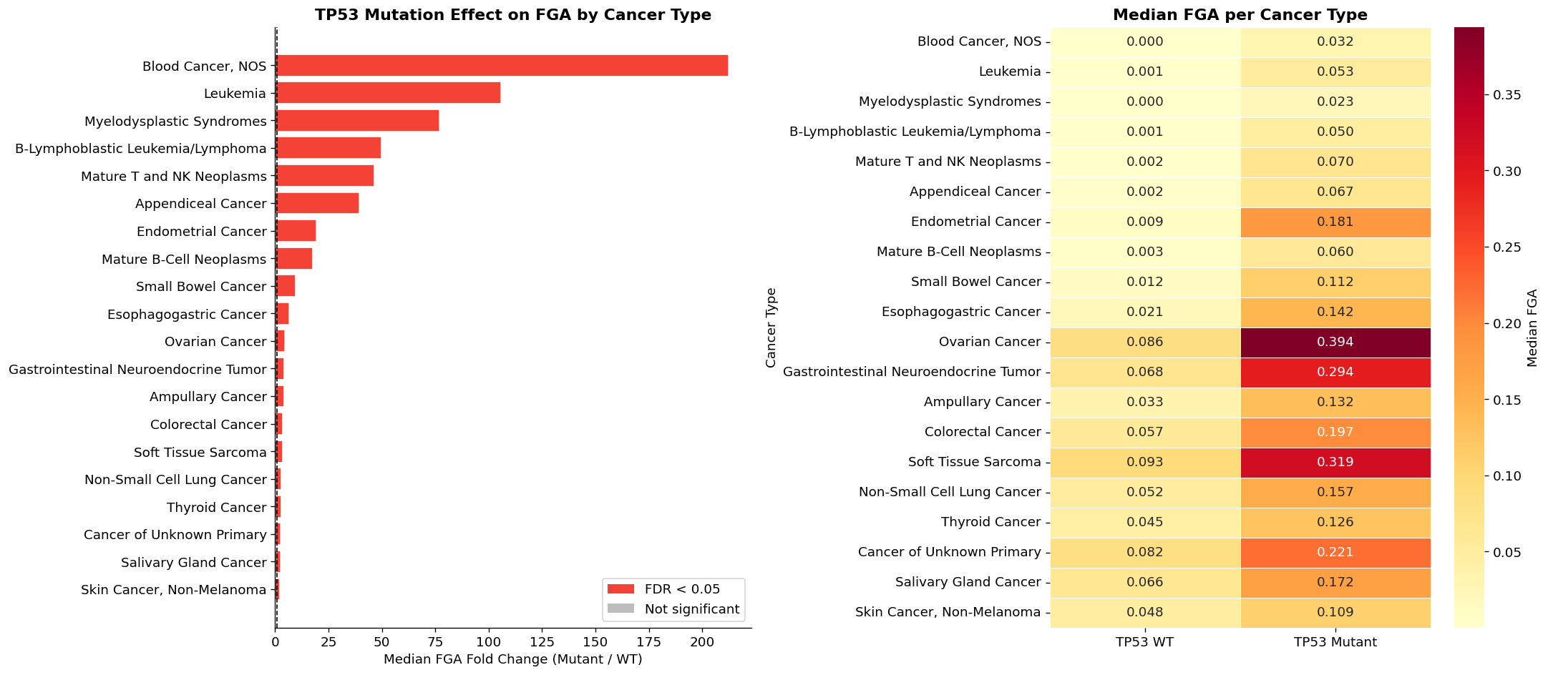
Results
Is this cancer-type specific?
All top absolute FGA cancers are solid tumors (Ovarian Cancer, Soft Tissue Sarcoma, and Colorectal Cancer).
The blood cancers have the highest fold change but tiny absolute FGA values (~0.03–0.07) because their WT baseline is essentially zero.

Slide 15
Discussion
Conclusions
The binary effect (mutant vs WT) is stronger than the continuous effect (EFS vs FGA).
This suggests a threshold model: once TP53 changes its function, genomic chaos follows, but the specific degree of functional loss matters less than its presence
Other tumor-intrinsic and tissue-specific factors play a larger role

Slide 16
Discussion
Conclusions
Hotspot mutations dominate in tumors not because they're functionally the worst (Giacomelli showed this), but because their DNA sequences are highly mutable. Yet they still drive genomic instability, consistent with the threshold model.

Slide 17
Discussion
Constrains and future directions
EFS derived from one lung cell line. That may not generalize across tissues
FGA is a bulk measure, and it doesn’t capture which specific chromosomal regions break

Slide 18
Thank you!
Notes:
pandas, numpy: data wrangling
scipy.stats: statistical tests
Statsmodels: BH FDR correction (multipletests)
matplotlib, seaborn: visualization

